Slide 1
Chapter 36
Real Options

Slide 2
An Alternative to the NPV Rule for Capital Investments
Define stochastic processes for the key underlying variables and use risk-neutral valuation
This approach (known as the real options approach) is likely to do a better job at valuing growth options, abandonment options, etc than NPV

Slide 3
The Problem with using NPV to Value Options
Consider the example from Chapter 13: risk-free rate =4%; strike price = $21
Suppose that the expected return required by investors in the real world on the stock is 10%. What discount rate should we use to value an option with strike price $21?
Stock Price = $22
Stock price = $20
Stock Price=$18

Slide 4
Correct Discount Rates are Counter-Intuitive
Correct discount rate for a call option is 55.96%
Correct discount rate for a put option is –70.4%

Slide 5
General Approach to Valuation
We can value any asset dependent on a variable θ by
  Reducing the expected growth rate of θ by λs where λ is the market price of θ-risk and s is the volatility of θ
  Assuming that all investors are risk-neutral

Slide 6
Extension to Many Underlying Variables
When there are several underlying variables θ_{i} we reduce the growth rate of each one by its market price of risk times its volatility and then behave as though the world is risk-neutral
Note that the variables do not have to be prices of traded securities

Slide 7
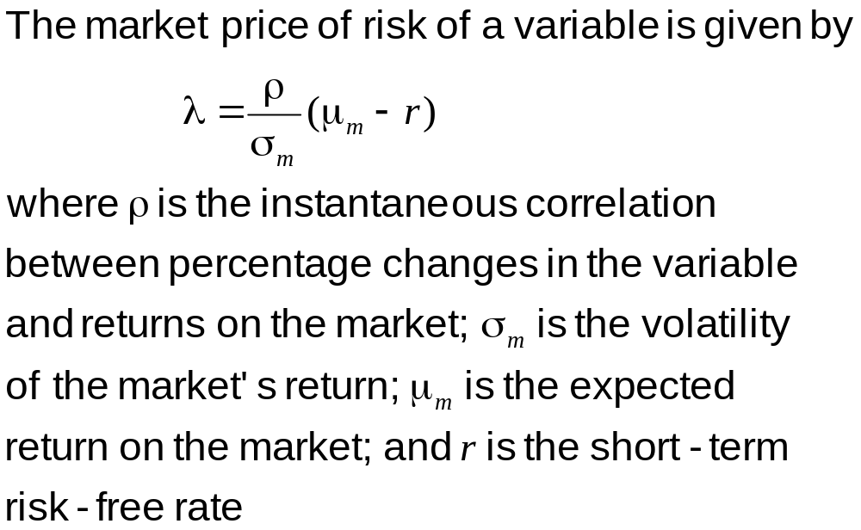
Estimating the Market Price of Risk Using CAPM (equation 36.2)

Slide 8
Types of Options
Abandonment
Expansion
Contraction
Option to defer
Option to extend life

Slide 9
Example of Application of Real Options Approach to Valuing Amazon.com at end of 1999 (Business Snapshot 36.1; Schwartz and Moon)
Estimate stochastic processes for the company’s sales revenue and its average growth rate.
Estimated the market price of risk and other key parameters (cost of goods sold as a percent of sales, variable expenses as a percent of sales, fixed expenses, etc.)
Use Monte Carlo simulation to generate different scenarios in a risk-neutral world.
The stock price is the average of the present values of the net cash flows discounted at the risk-free rate.

Slide 10
Example
A company has to decide whether to invest $15 million to obtain 6 million units of a commodity at the rate of 2 million units per year for three years.
The fixed operating costs are $6 million per year and the variable costs are $17 per unit.
The spot price of the commodity is $20 per unit and 1, 2, and 3-year futures prices are $22, $23, and $24, respectively.
The risk-free rate is 10% per annum for all maturities.

Slide 11
The Process for the Commodity Price
We assume that this is
d ln(S) = [θ(t) − aln(S)] dt + σ dz
where a = 0.1 and σ = 0.2
We build a tree as in Chapter 33

Slide 12
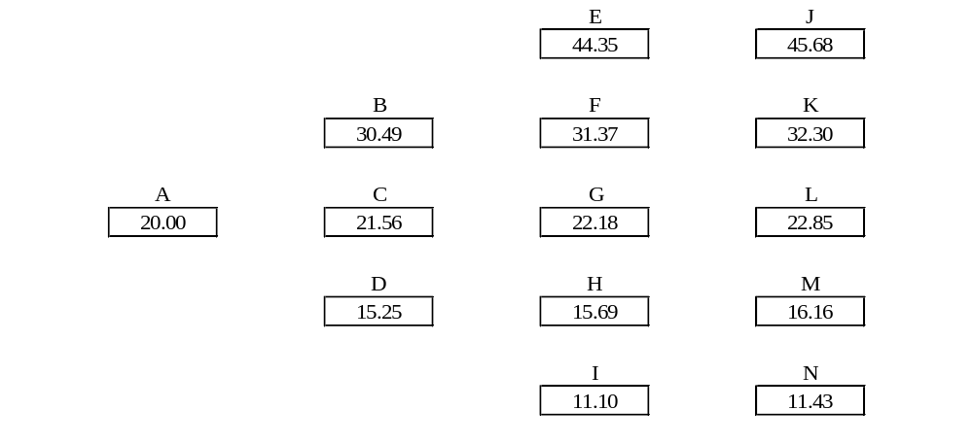
The Tree of Commodity Prices (Figure 36.1)
Node | A | B | C | D | E | F | G | H | I
p_{u} | 0.1667 | 0.1217 | 0.1667 | 0.2217 | 0.8867 | 0.1217 | 0.1667 | 0.2217 | 0.0867
p_{m} | 0.6666 | 0.6566 | 0.6666 | 0.6566 | 0.0266 | 0.6566 | 0.6666 | 0.6566 | 0.0266
p_{d} | 0.1667 | 0.2217 | 0.1667 | 0.1217 | 0.0867 | 0.2217 | 0.1667 | 0.1217 | 0.8867

Slide 13
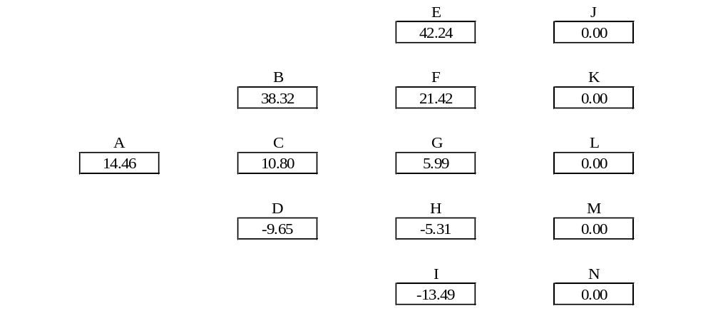
Valuation of Base Project (Figure 36.2)
Node | A | B | C | D | E | F | G | H | I
p_{u} | 0.1667 | 0.1217 | 0.1667 | 0.2217 | 0.8867 | 0.1217 | 0.1667 | 0.2217 | 0.0867
p_{m} | 0.6666 | 0.6566 | 0.6666 | 0.6566 | 0.0266 | 0.6566 | 0.6666 | 0.6566 | 0.0266
p_{d} | 0.1667 | 0.2217 | 0.1667 | 0.1217 | 0.0867 | 0.2217 | 0.1667 | 0.1217 | 0.8867

Slide 14

Valuation of Option to Abandon (Figure 36.3)
No Salvage Value; No Further Payments
Node | A | B | C | D | E | F | G | H | I
p_{u} | 0.1667 | 0.1217 | 0.1667 | 0.2217 | 0.8867 | 0.1217 | 0.1667 | 0.2217 | 0.0867
p_{m} | 0.6666 | 0.6566 | 0.6666 | 0.6566 | 0.0266 | 0.6566 | 0.6666 | 0.6566 | 0.0266
p_{d} | 0.1667 | 0.2217 | 0.1667 | 0.1217 | 0.0867 | 0.2217 | 0.1667 | 0.1217 | 0.8867

Slide 15
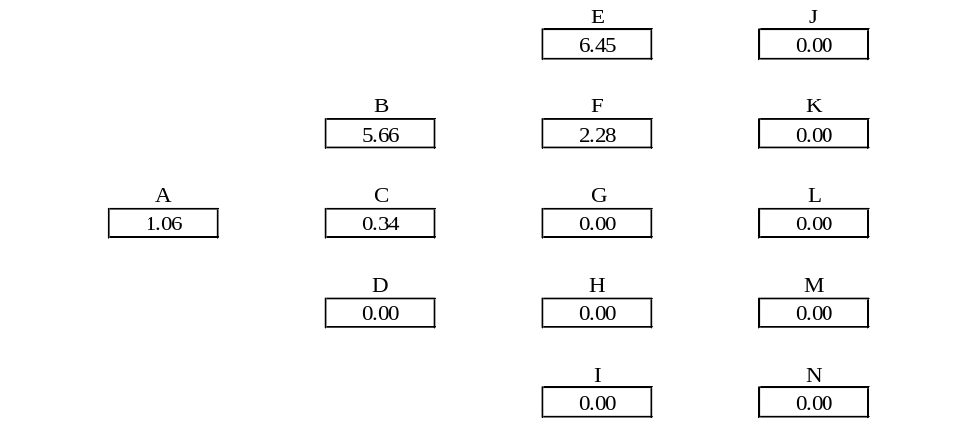
Value of Expansion Option; Figure 36.4 (Company Can Increase Scale of Project by 20% for $2 million)
Node | A | B | C | D | E | F | G | H | I
p_{u} | 0.1667 | 0.1217 | 0.1667 | 0.2217 | 0.8867 | 0.1217 | 0.1667 | 0.2217 | 0.0867
p_{m} | 0.6666 | 0.6566 | 0.6666 | 0.6566 | 0.0266 | 0.6566 | 0.6666 | 0.6566 | 0.0266
p_{d} | 0.1667 | 0.2217 | 0.1667 | 0.1217 | 0.0867 | 0.2217 | 0.1667 | 0.1217 | 0.8867

